Slide 1
Flappy Bird Clone
Made BY :
Devansh Aggarwal - 2210990258
22CS016

Slide 2
Index
Objective
Introduction
What is Pygame?
Source Code (screenshots)
Result
Conclusion
Future Scope
Reference
22CS016

Slide 3
Objective
To create a flappy bird look – alike using Pygame.
To use python to make a fully functional and fun game.
To learn game development by making a popular game clone.
To showcase and learn from this opportunity to make a project

Slide 4
What is Pygame?
Pygame is a Python library specifically designed for creating video games.
It provides developers with a set of modules and functions that facilitate game development, including graphics rendering, sound playback, event handling, and more.
Pygame is built on top of the Simple DirectMedia Layer (SDL), a popular cross-platform multimedia library, which allows for efficient and platform-independent game development.

Slide 5
Introduction
Flappy Bird is a 2D side-scrolling game that gained immense popularity for its straightforward gameplay and deceptively challenging mechanics.
This project aims to make a flappy bird look – alike.
The simplicity of Flappy Bird makes it an ideal starting point for those new to game development, while still offering challenges for more experienced developers.

Slide 6
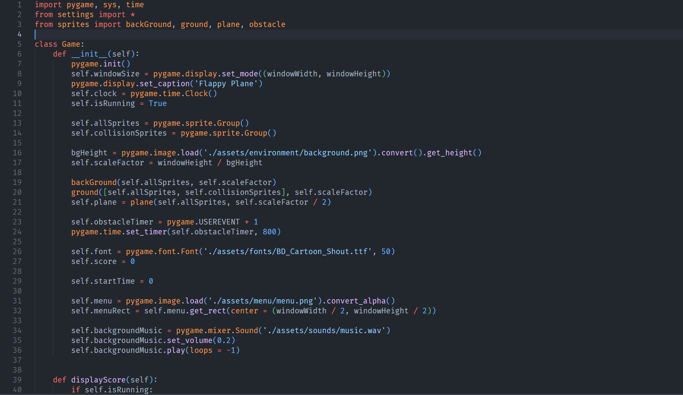
Source Code

Slide 7
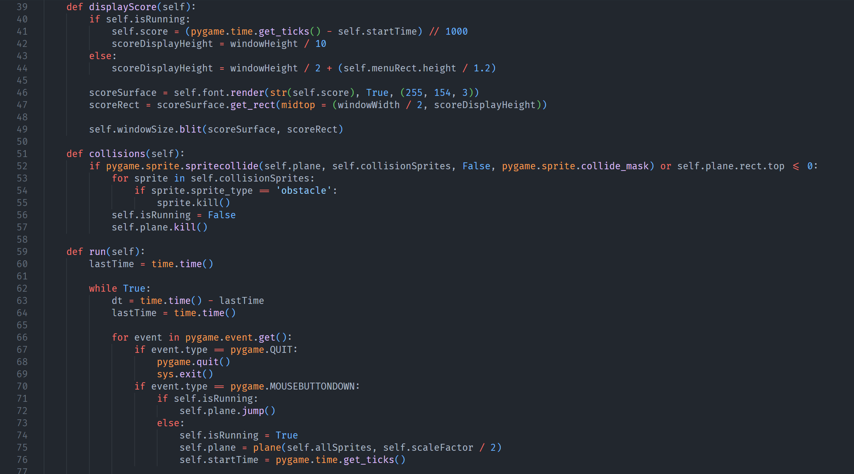
Source Code

Slide 8
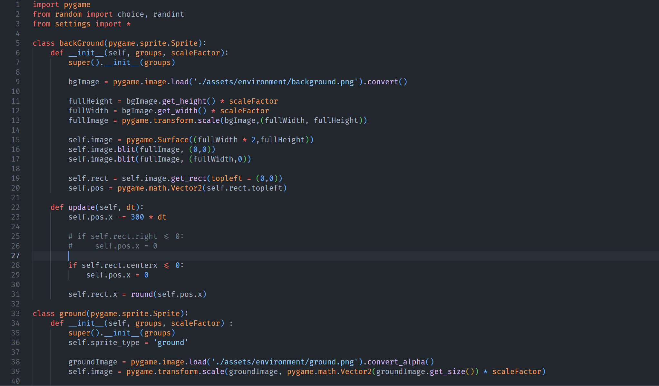
Source Code

Slide 9
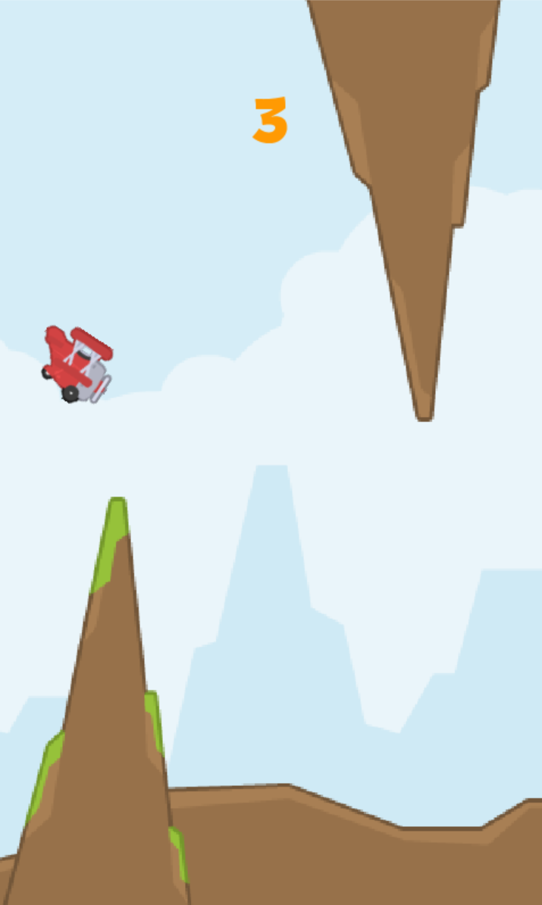
SCREENSHOTS(WEBSITE)

Slide 10
Conclusion
Our Flappy Bird clone successfully captures the essence of the original game. Players can control the bird, navigate through obstacles, and experience the challenging yet addictive gameplay that made Flappy Bird a sensation.
The fundamental mechanics of Flappy Bird have been faithfully replicated. From our character’s responsiveness to the moving obstacles and collision detection, our clone closely mirrors the iconic gameplay that captivated players worldwide.

Slide 11
Future Scope
I plan on adding a lot more content to the game, like :
A game menu
An option to switch difficulty levels
An option to change your characters
And lastly, an option to change the background of the game.

Slide 12
Reference
1.) https://www.pygame.org/docs/
2.) https://www.w3schools.com/
3.) https://stackoverflow.com/
22CS016

Slide 13
End of Presentation.
22CS016

